Slide 1
Indexing local features and instance recognition (Szeliski 14.1 and Grauman&Liebe 1-4)
Michael S. Ryoo

Slide 2
Reminder
Programming assignments: we will have two days of allowed late submission(s).
(2 * one-day-late) or (1 * two-days-late)
10% penalty per day
The amount of max penalty is 50%

Slide 3
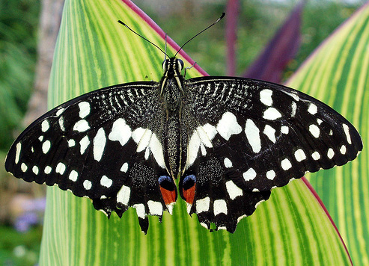
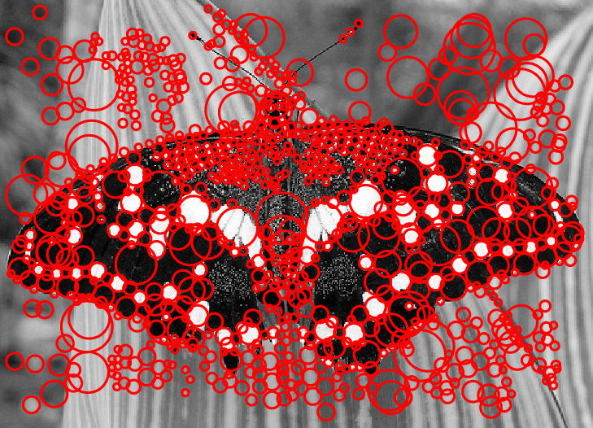
Local features
Image credit: Lana Lazebnik

Slide 4
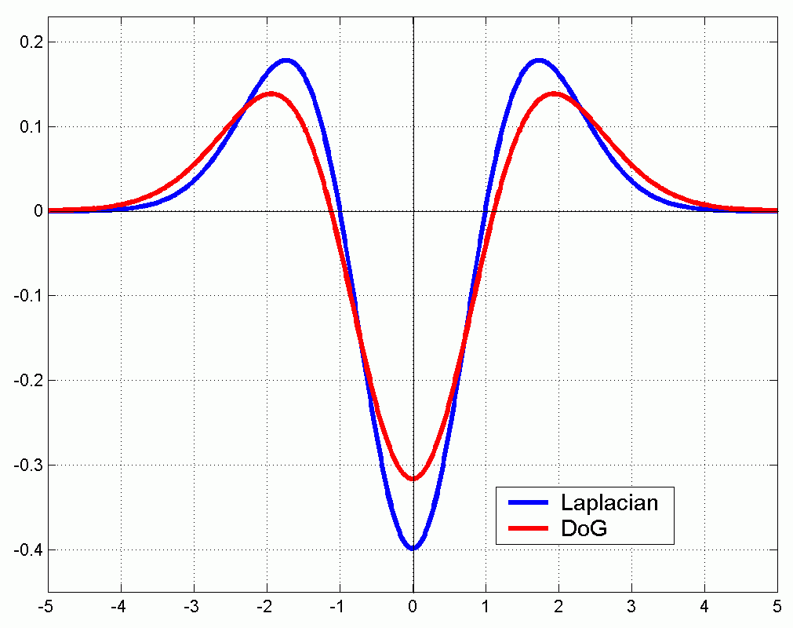
Approximating the Laplacian
We can approximate the Laplacian with a difference of Gaussians; more efficient to implement.
(Laplacian)
(Difference of Gaussians)

Slide 5

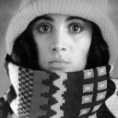

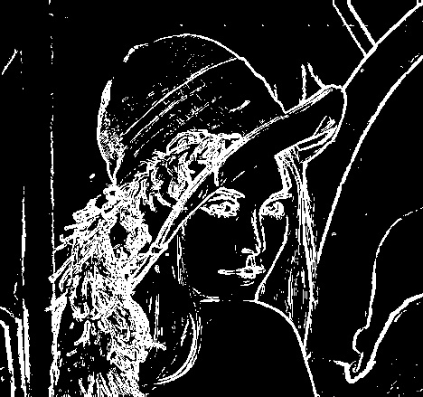
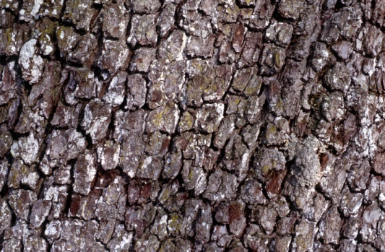

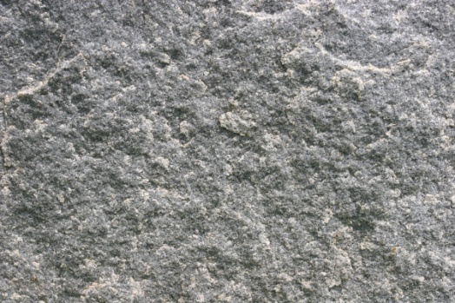
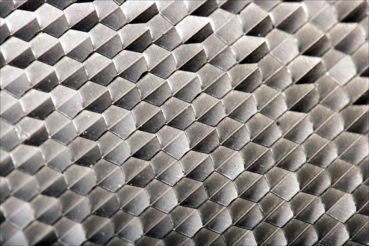
Recap: Features and filters
Transforming and describing images; textures, colors, edges
Kristen Grauman

Slide 6
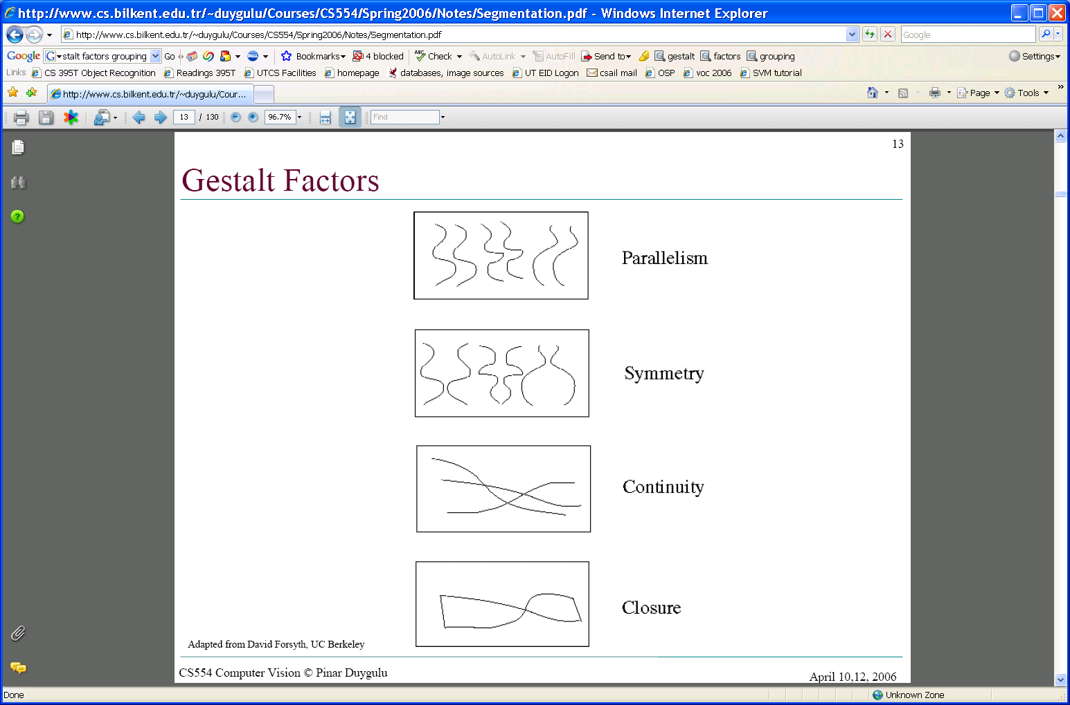
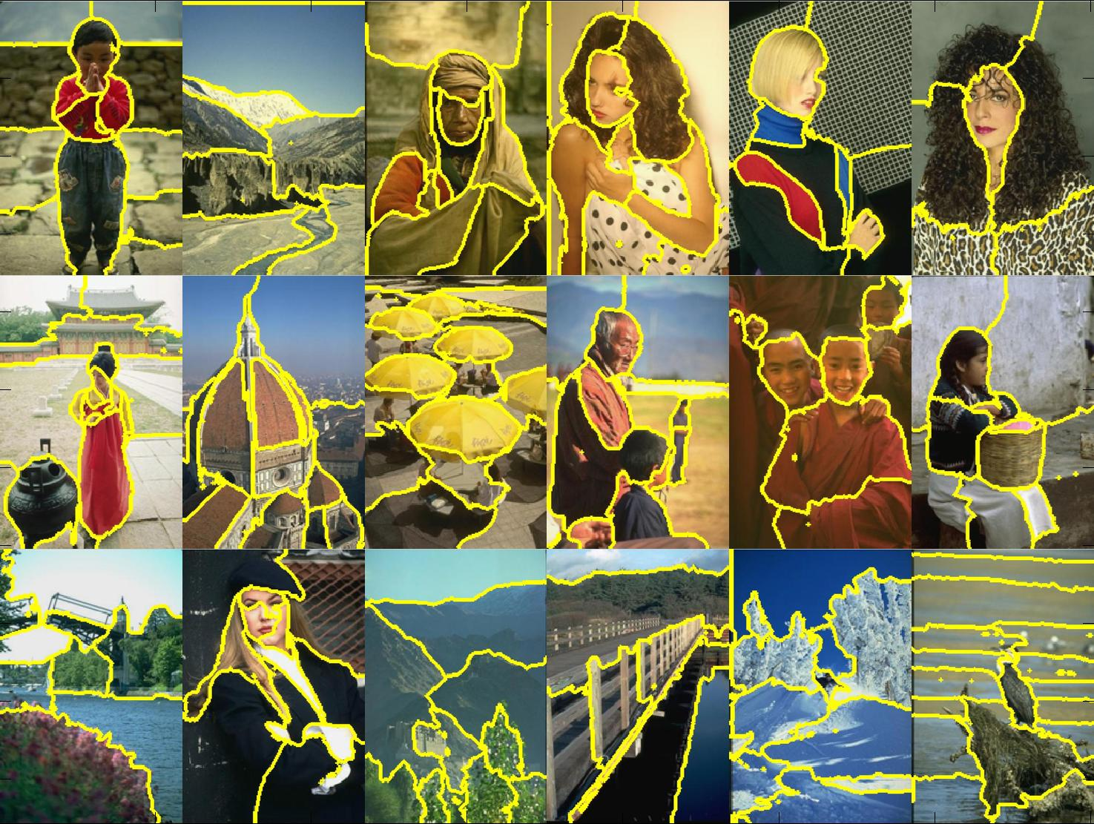
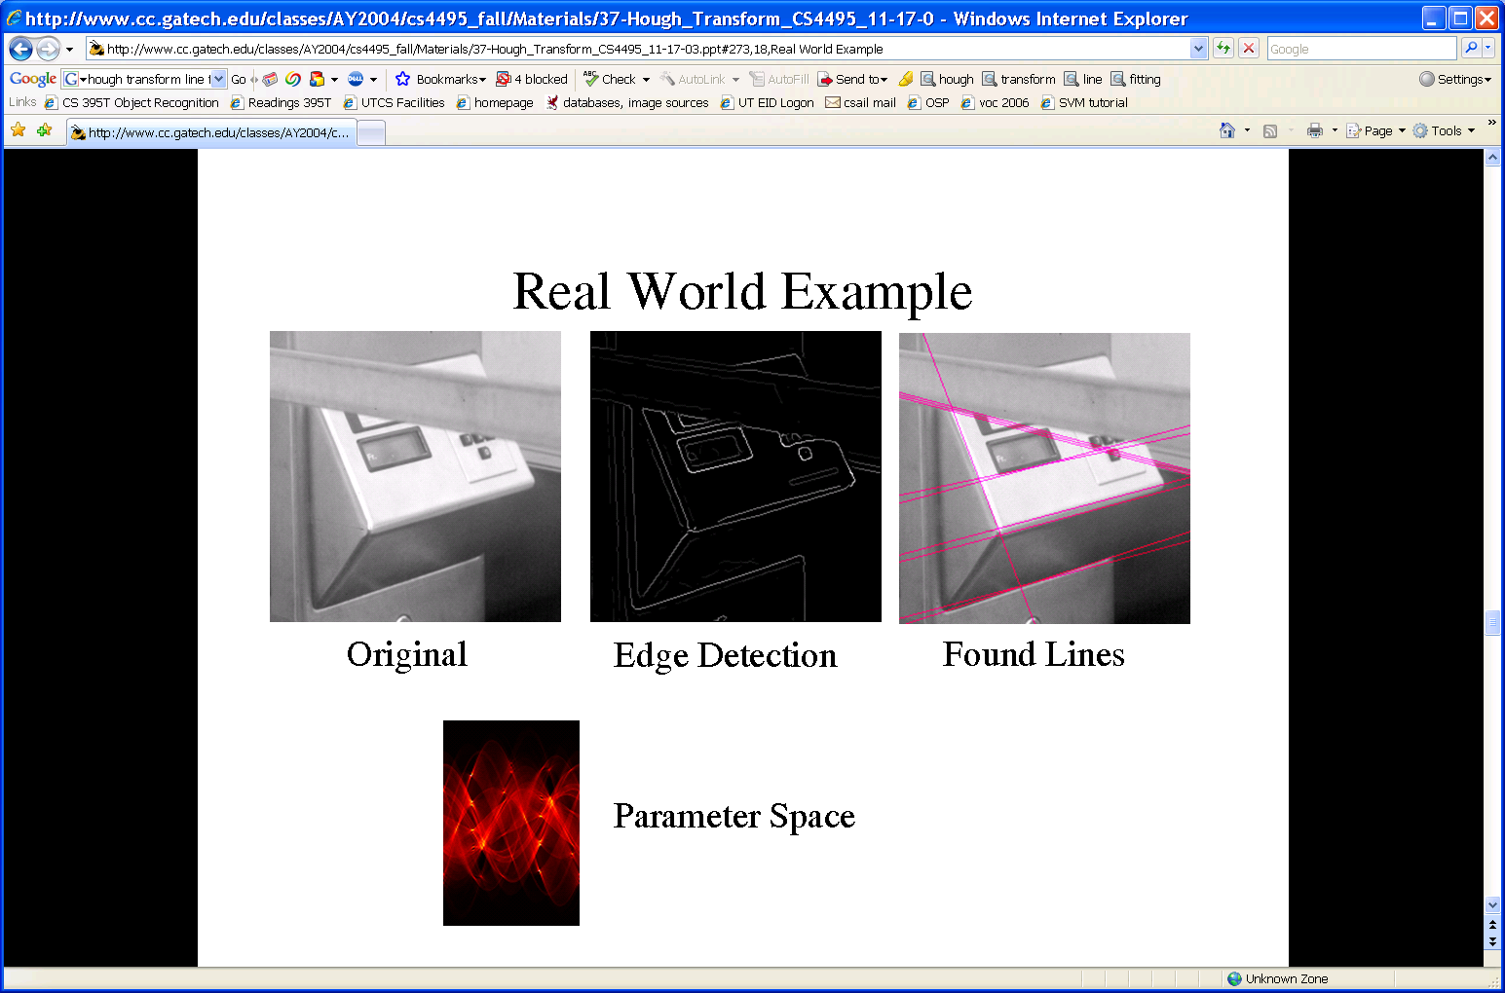
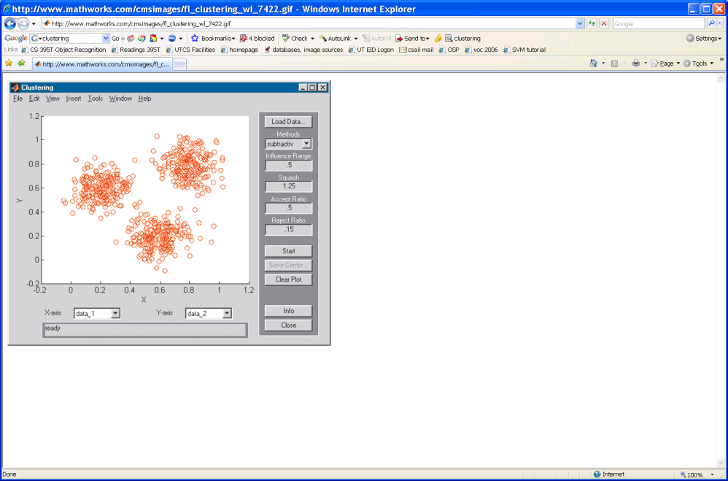
Recap: Grouping & fitting
Clustering, segmentation, fitting; what parts belong together?
[fig from Shi et al]
Kristen Grauman

Slide 7
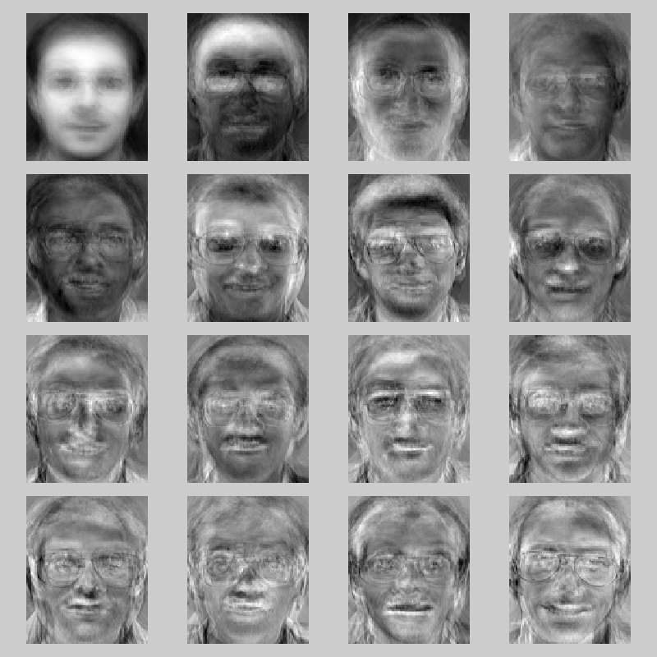
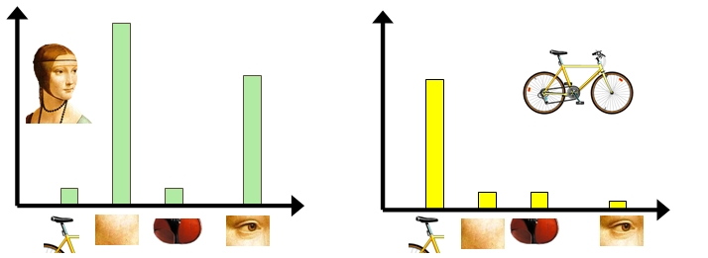

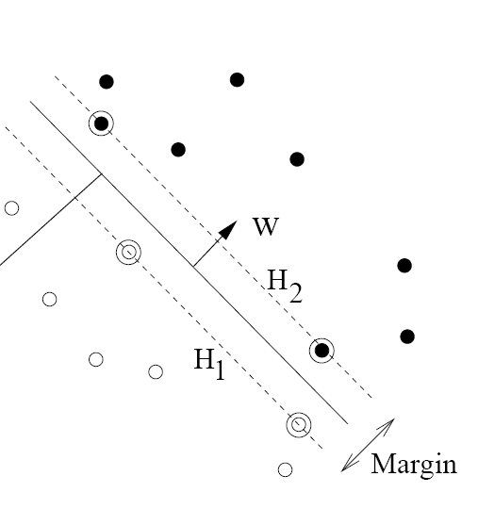
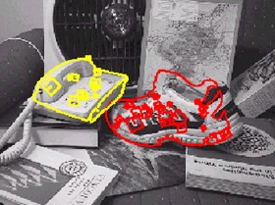
Recognition and learning
Recognizing objects and categories, learning techniques
Kristen Grauman

Slide 8
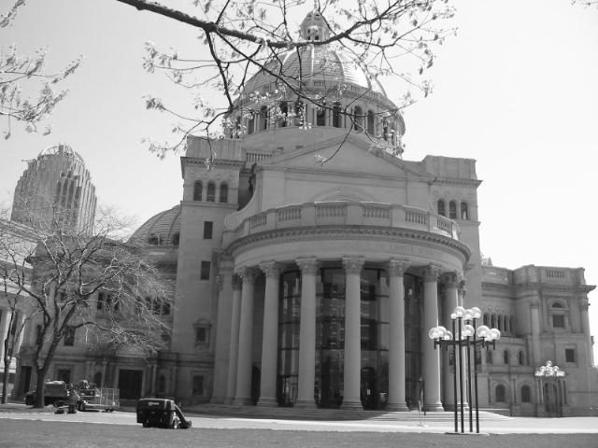
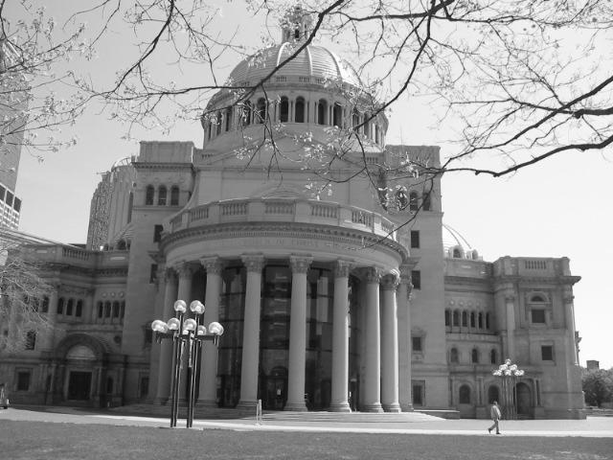
Matching local features
Kristen Grauman

Slide 9
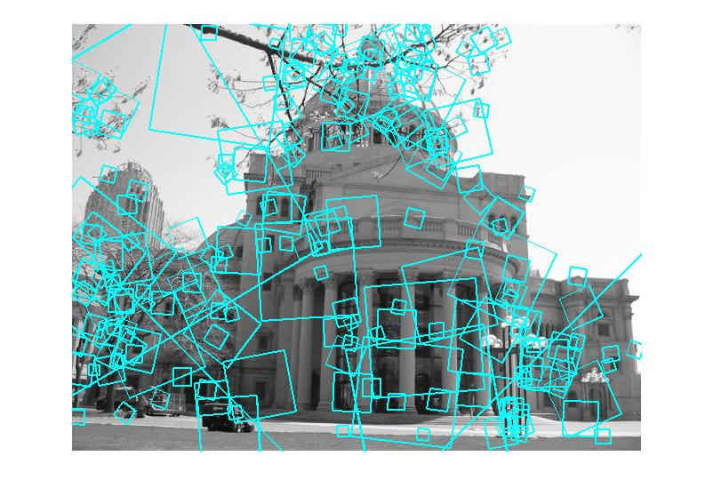
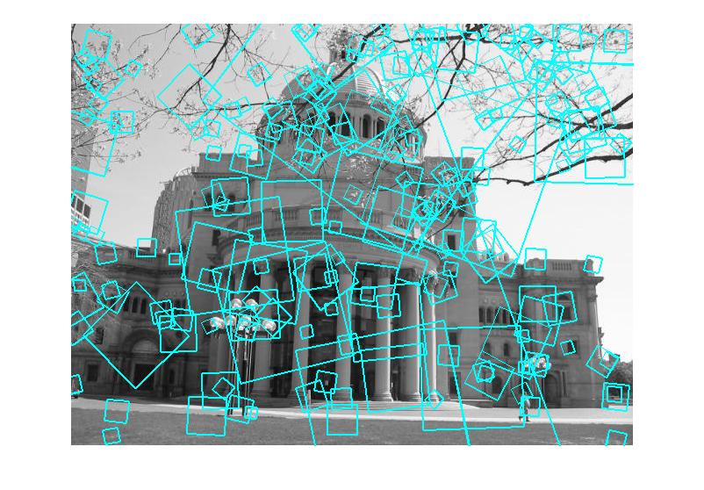
Matching local features
?
Image 1
Image 2
To generate candidate matches, find patches that have the most similar appearance (e.g., lowest SSD)
Simplest approach: compare them all, take the closest (or closest k, or within a thresholded distance)
Kristen Grauman

Slide 10
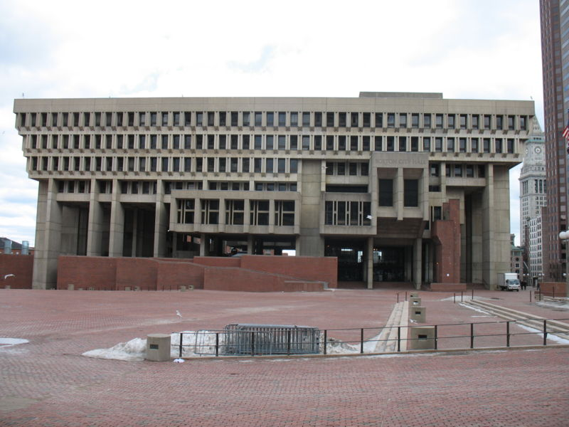
Indexing local features
…
Kristen Grauman
Notes:
Map local descriptors to discrete tokens, and then “match” them by simply looking up features assigned to identical tokens.

Slide 11
Indexing local features
Each patch / region has a descriptor, which is a point in some high-dimensional feature space (e.g., SIFT)
Descriptor’s feature space
Kristen Grauman
Notes:
11

Slide 12
Indexing local features
When we see close points in feature space, we have similar descriptors, which indicates similar local content.
Query image
Descriptor’s feature space
Database images
Kristen Grauman

Slide 13
Indexing local features
With potentially thousands of features per image, and hundreds to millions of images to search, how to efficiently find those that are relevant to a new image?
Kristen Grauman
Notes:
13

Slide 14
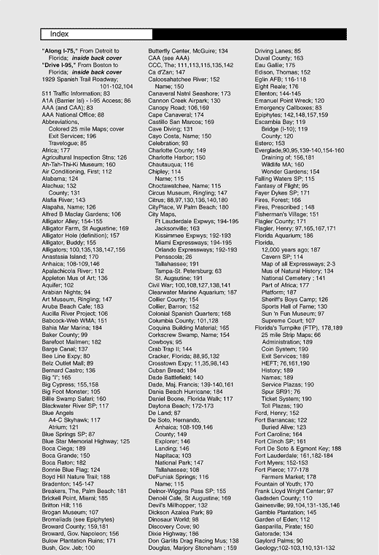
Indexing local features: inverted file index
For text documents, an efficient way to find all pages on which a word occurs is to use an index…
We want to find all images in which a feature occurs.
To use this idea, we’ll need to map our features to “visual words”.
Kristen Grauman

Slide 15
Text retrieval vs. image search
What makes the problems similar, different?
Kristen Grauman
Notes:
Text words are discrete “tokens”, whereas local image descriptors are high-dimensional, real-valued feature points. Need to quantize the visual features into discrete visual words.

Slide 16
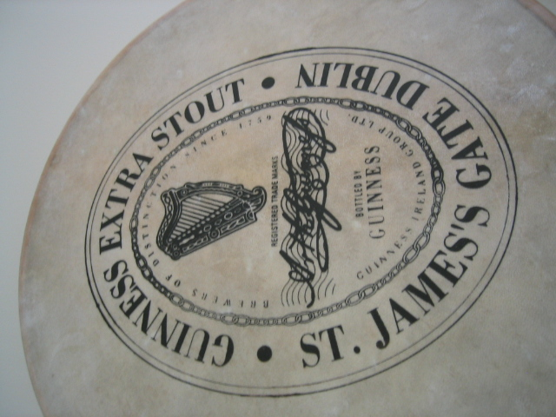
Visual words: main idea
Extract some local features from a number of images …
e.g., SIFT descriptor space: each point is 128-dimensional
Slide credit: D. Nister, CVPR 2006

Slide 17
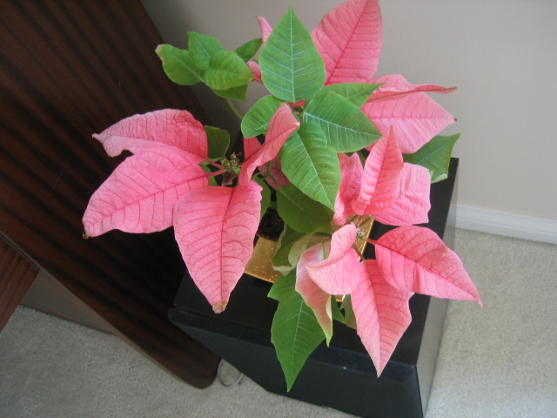
Visual words: main idea

Slide 18
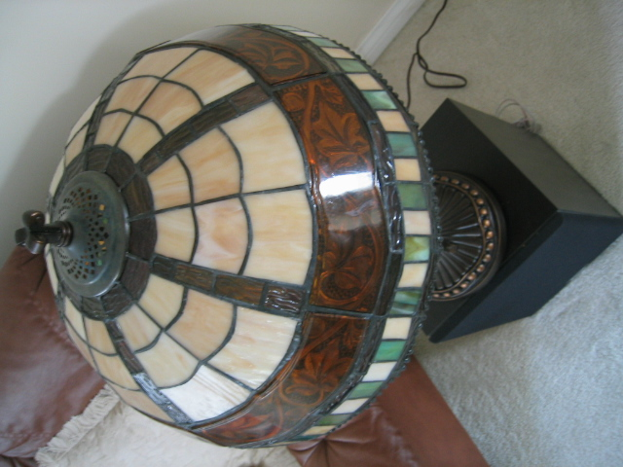
Visual words: main idea

Slide 19

Visual words: main idea

Slide 20
Each point is a local descriptor, e.g. SIFT vector.

Slide 22
Visual words
Map high-dimensional descriptors to tokens/words by quantizing the feature space
Quantize via clustering, let cluster centers be the prototype “words”
Word #2
Determine which word to assign to each new image region by finding the closest cluster center.
Descriptor’s feature space
Kristen Grauman

Slide 23
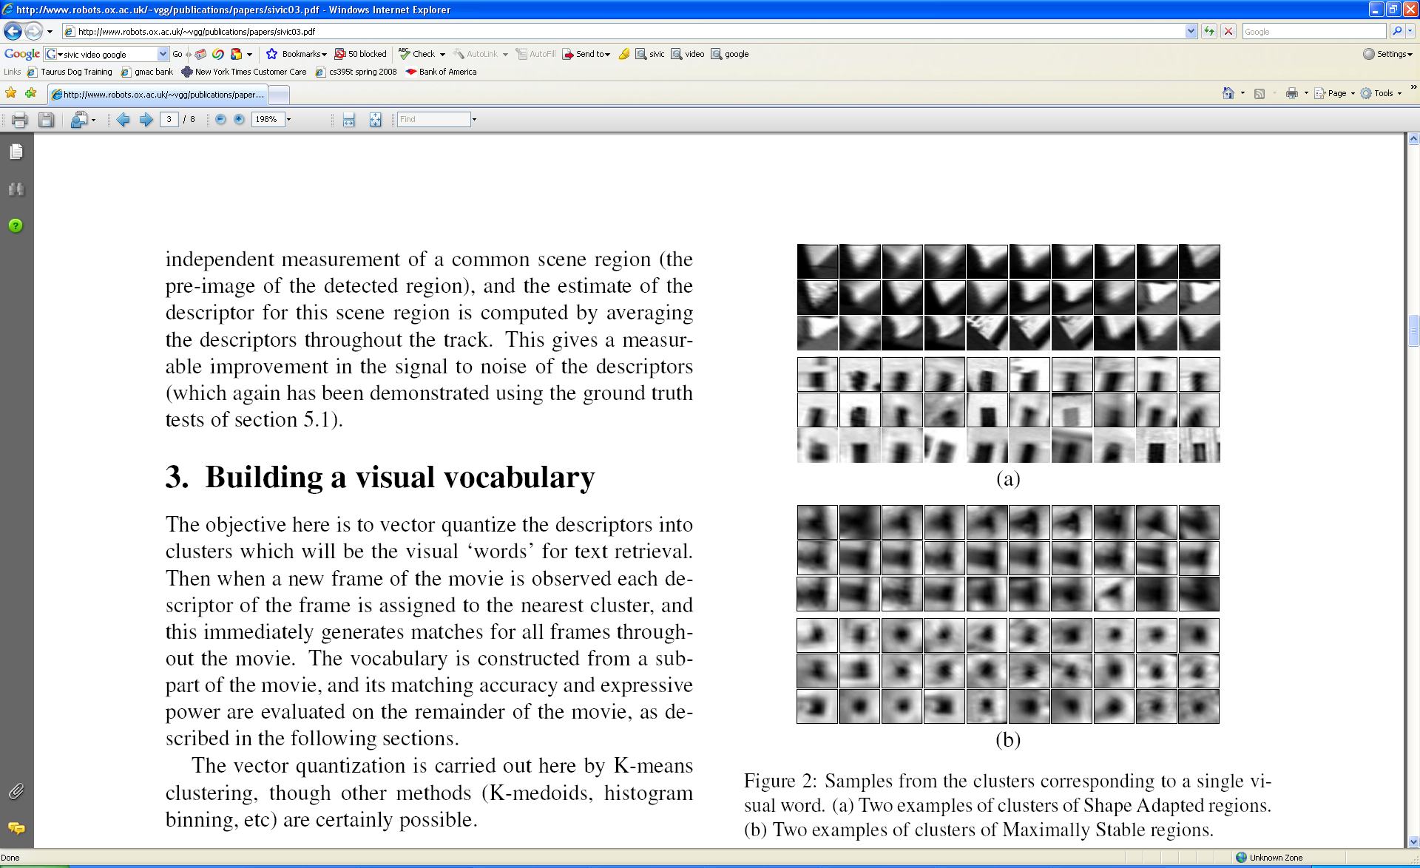
Visual words
Example: each group of patches belongs to the same visual word
Figure from Sivic & Zisserman, ICCV 2003
Kristen Grauman

Slide 24
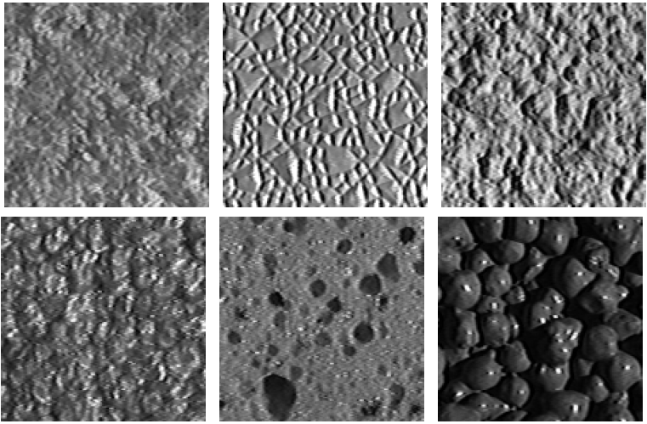
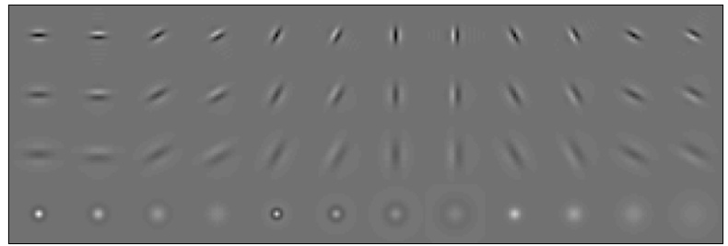
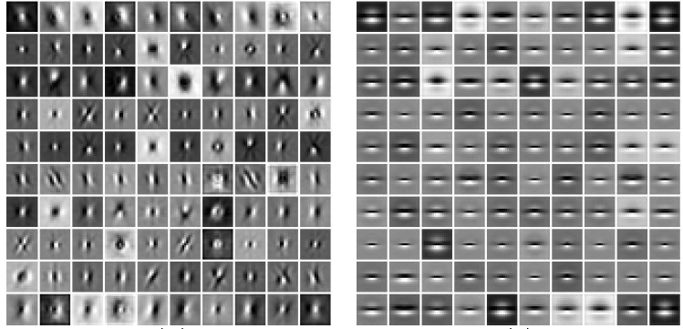
Visual words and textons
First explored for texture and material representations
Texton = cluster center of filter responses over collection of images
Describe textures and materials based on distribution of prototypical texture elements.
Leung & Malik 1999; Varma & Zisserman, 2002
Kristen Grauman

Slide 25
Recall: Texture representation example
Windows with primarily horizontal edges
Both
 | mean d/dx value | mean d/dy value
Win. #1 | 4 | 10
Win.#2 | 18 | 7
Win.#9 | 20 | 20
Dimension 2 (mean d/dy value)
Dimension 1 (mean d/dx value)
…
statistics to summarize patterns in small windows
…
Windows with small gradient in both directions
Windows with primarily vertical edges
Kristen Grauman

Slide 26
Visual vocabulary formation
Issues:
Sampling strategy: where to extract features?
Clustering / quantization algorithm
Unsupervised vs. supervised
What corpus provides features (universal vocabulary?)
Vocabulary size, number of words
Kristen Grauman

Slide 27
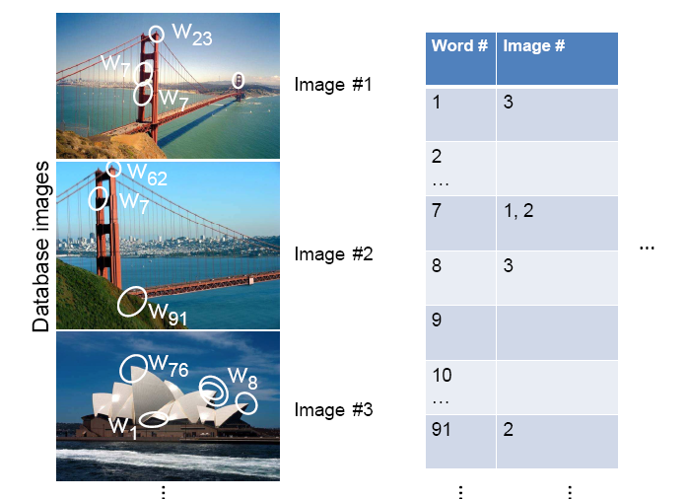
Inverted file index
Database images are loaded into the index mapping words to image numbers
Kristen Grauman

Slide 28
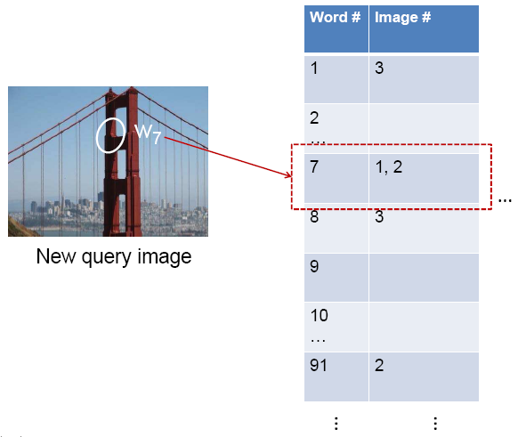
Inverted file index
When will this give us a significant gain in efficiency?
New query image is mapped to indices of database images that share a word.
Kristen Grauman

Slide 29
If a local image region is a visual word, how can we summarize an image (the document)?

Slide 30

Analogy to documents
Of all the sensory impressions proceeding to the brain, the visual experiences are the dominant ones. Our perception of the world around us is based essentially on the messages that reach the brain from our eyes. For a long time it was thought that the retinal image was transmitted point by point to visual centers in the brain; the cerebral cortex was a movie screen, so to speak, upon which the image in the eye was projected. Through the discoveries of Hubel and Wiesel we now know that behind the origin of the visual perception in the brain there is a considerably more complicated course of events. By following the visual impulses along their path to the various cell layers of the optical cortex, Hubel and Wiesel have been able to demonstrate that the message about the image falling on the retina undergoes a step-wise analysis in a system of nerve cells stored in columns. In this system each cell has its specific function and is responsible for a specific detail in the pattern of the retinal image.
China is forecasting a trade surplus of $90bn (£51bn) to $100bn this year, a threefold increase on 2004's $32bn. The Commerce Ministry said the surplus would be created by a predicted 30% jump in exports to $750bn, compared with a 18% rise in imports to $660bn. The figures are likely to further annoy the US, which has long argued that China's exports are unfairly helped by a deliberately undervalued yuan. Beijing agrees the surplus is too high, but says the yuan is only one factor. Bank of China governor Zhou Xiaochuan said the country also needed to do more to boost domestic demand so more goods stayed within the country. China increased the value of the yuan against the dollar by 2.1% in July and permitted it to trade within a narrow band, but the US wants the yuan to be allowed to trade freely. However, Beijing has made it clear that it will take its time and tread carefully before allowing the yuan to rise further in value.
sensory, brain,
visual, perception,
retinal, cerebral cortex,
eye, cell, optical
nerve, image
Hubel, Wiesel
China, trade,
surplus, commerce,
exports, imports, US,
yuan, bank, domestic,
foreign, increase,
trade, value
ICCV 2005 short course, L. Fei-Fei

Slide 31
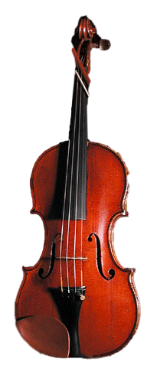
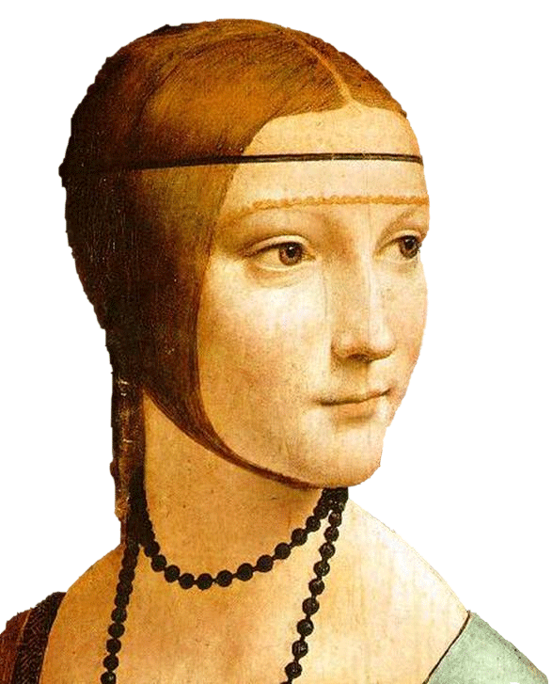
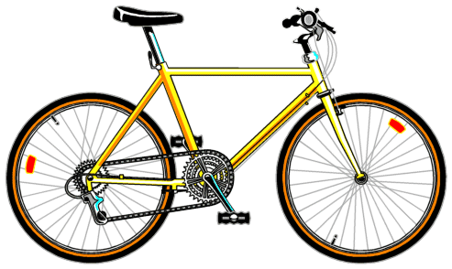
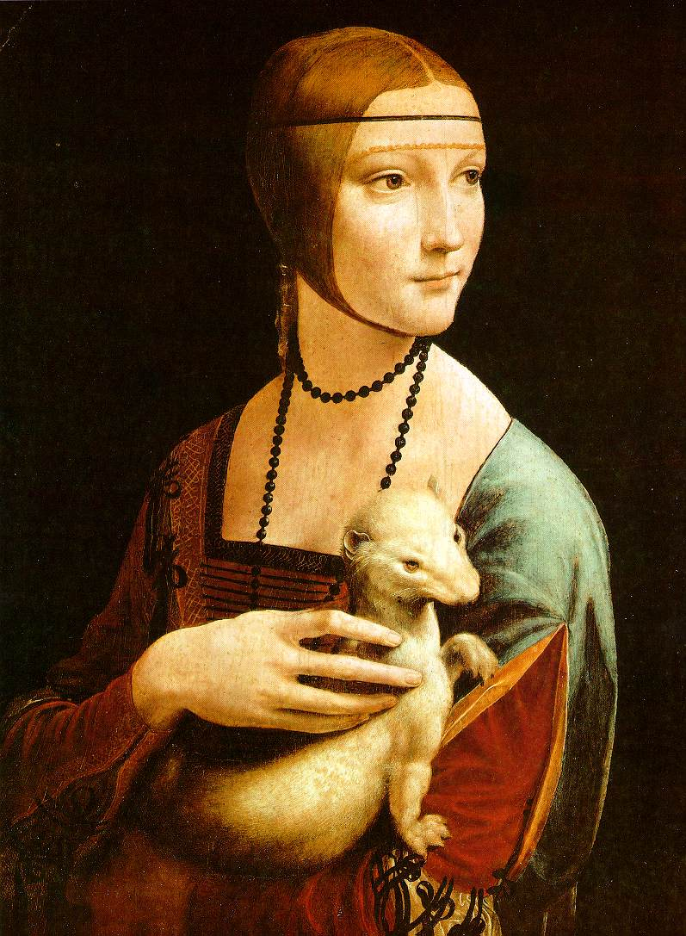

Slide 32
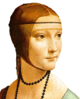
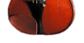

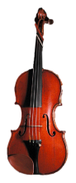

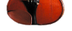

Bags of visual words
Summarize entire image based on its distribution (histogram) of word occurrences.
Analogous to bag of words representation commonly used for documents.
Notes:
32

Slide 33
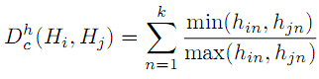
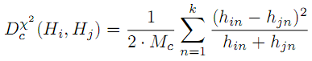

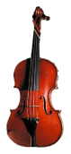



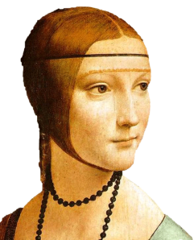
Comparing bags of words
Multiple different types of ‘kernels’ can be used to measure the ‘distance’ between histograms --nearest neighbor search for similar images.
[1 8 1 4]
[5 1 1 0]
for vocabulary of k words
Notes:
(possibly weighted)
Cosine similarity

Slide 34
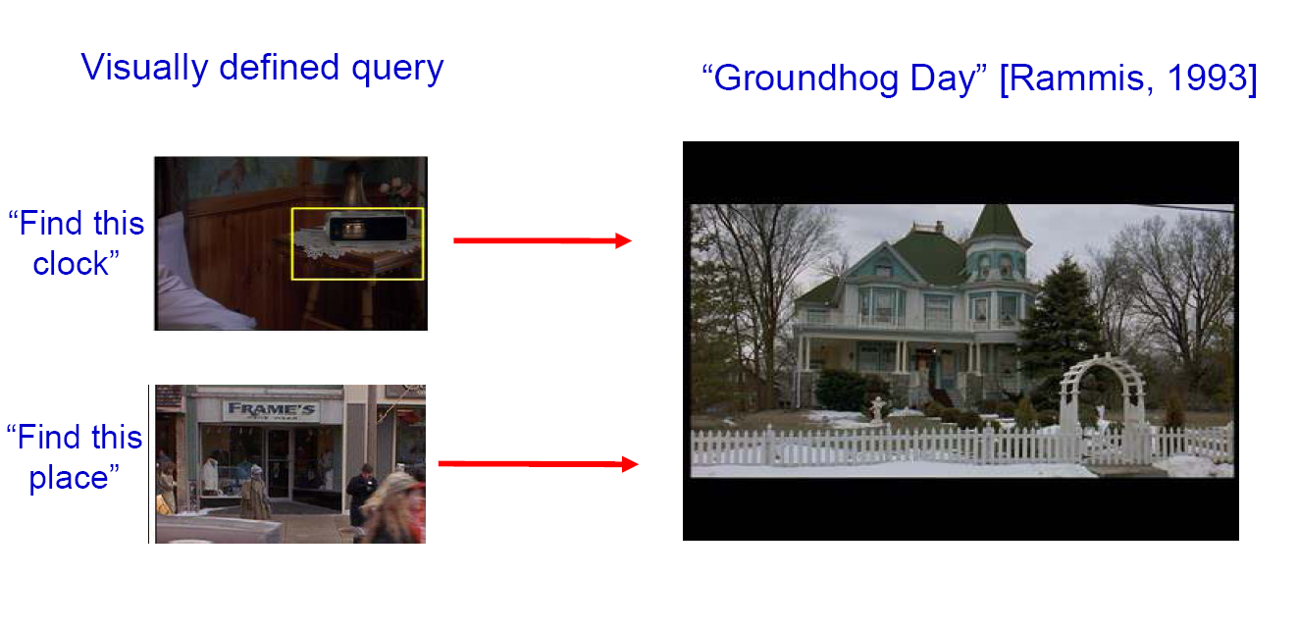
Bags of words for content-based image retrieval
Slide from Andrew Zisserman
Sivic & Zisserman, ICCV 2003

Slide 35
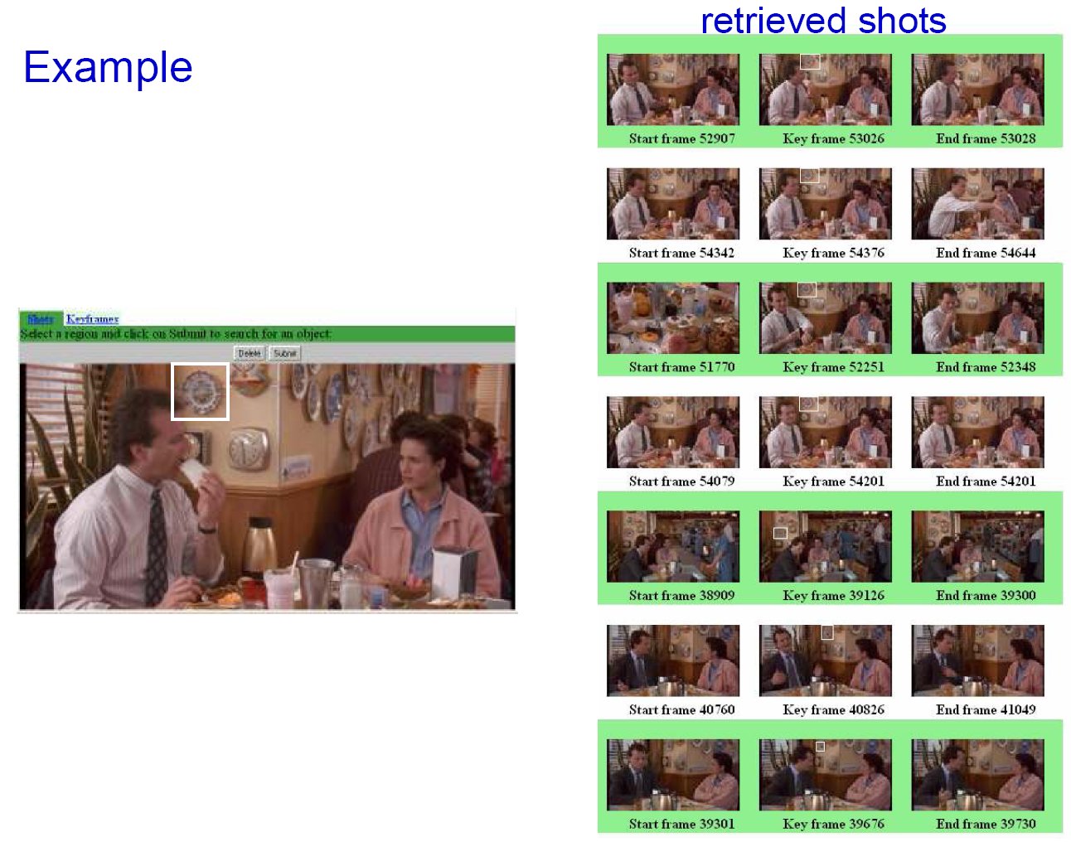
Slide from Andrew Zisserman
Sivic & Zisserman, ICCV 2003

Slide 36
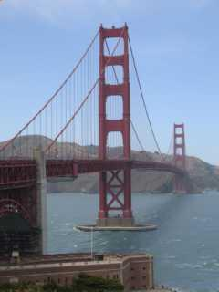
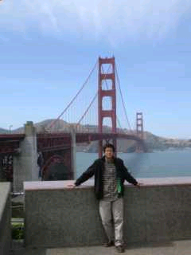
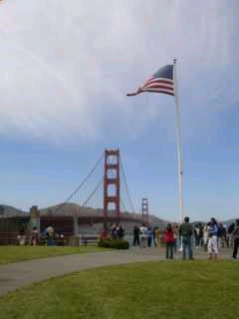
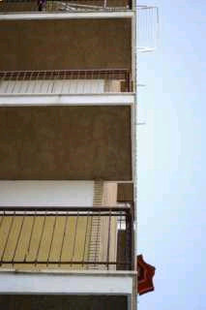
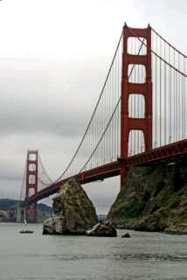






Scoring retrieval quality
Results (ordered):
Database size: 10 images
Relevant (total): 5 images
Query
precision = #relevant / #returned
recall = #relevant / #total relevant
1
0.8
0.6
precision
0.4
0.2
0
0
0.2
0.4
0.6
0.8
1
recall
Slide credit: Ondrej Chum

Slide 37
Bags of words: pros and cons
+ flexible to geometry / deformations / viewpoint
+ compact summary of image content
+ provides vector representation for sets
+ good results in practice
basic model ignores geometry – must verify afterwards, or encode via features
background and foreground mixed when bag covers whole image
optimal vocabulary formation remains unclear
Notes:
37

Slide 38
Summary So Far
Matching local invariant features: useful to provide matches to find objects and scenes.
Bag of words representation: quantize feature space to make discrete set of visual words
Inverted index: pre-compute index to enable faster search at query time

Slide 39
Instance recognition
Motivation – visual search
Visual words
quantization, index, bags of words
Spatial verification
affine; RANSAC, Hough
Other text retrieval tools
tf-idf, query expansion
Example applications

Slide 40


Spatial Verification
Query
Query
DB image with high BoW similarity
DB image with high BoW similarity
Both image pairs have many visual words in common.
Slide credit: Ondrej Chum

Slide 41


Spatial Verification
Query
Query
DB image with high BoW similarity
DB image with high BoW similarity
Only some of the matches are mutually consistent
Slide credit: Ondrej Chum

Slide 42
Spatial Verification: two basic strategies
RANSAC
Typically sort by BoW similarity as initial filter
Verify by checking support (inliers) for possible transformations
e.g., “success” if find a transformation with > N inlier correspondences
Generalized Hough Transform
Let each matched feature cast a vote on location, scale, orientation of the model object
Verify parameters with enough votes
Kristen Grauman

Slide 43
RANSAC: alignment problem
We have previously considered how to fit a model to image evidence
e.g., a line/circle to edge points
In alignment, we will fit the parameters of some transformation according to a set of matching feature pairs (“correspondences”).
x_{i}
'
x_{i}
T
Kristen Grauman

Slide 44
Fitting an affine transformation
Assuming we know the correspondences, how do we get the transformation?

Slide 45




Parametric (global) warping
Examples of parametric warps:
translation
rotation
aspect
perspective
affine
Source: Alyosha Efros

Slide 46
Parametric (global) warping
T
p = (x,y)
p’ = (x’,y’)
Transformation T is a coordinate-changing machine:
p’ = T(p)
What does it mean that T is global?
Is the same for any point p
can be described by just a few numbers (parameters)
Let’s represent T as a matrix:
p’ = Mp
Source: Alyosha Efros

Slide 47
Scaling
Scaling a coordinate means multiplying each of its components by a scalar
Uniform scaling means this scalar is the same for all components:
× 2
Source: Alyosha Efros

Slide 48
Scaling
Non-uniform scaling: different scalars per component:
X × 2, Y × 0.5
Source: Alyosha Efros

Slide 49
Scaling
Scaling operation:
Or, in matrix form:
scaling matrix S
Source: Alyosha Efros

Slide 50
What transformations can be represented with a 2x2 matrix?
2D Scaling?
2D Rotate around (0,0)?
2D Shear?
Source: Alyosha Efros

Slide 51
What transformations can be represented with a 2x2 matrix?
2D Mirror about Y axis?
2D Mirror over (0,0)?
2D Translation?
NO!
Source: Alyosha Efros

Slide 52
2D Linear Transformations
Only linear 2D transformations can be represented with a 2x2 matrix.
Linear transformations are combinations of …
Scale,
Rotation,
Shear, and
Mirror
Source: Alyosha Efros

Slide 53
Homogeneous Coordinates
Q: How can we represent 2d translation as a 3x3 matrix using homogeneous coordinates?
A: Using the rightmost column:
Source: Alyosha Efros

Slide 54
Translation
Homogeneous Coordinates
t_{x} = 2 t_{y} = 1
Source: Alyosha Efros

Slide 55
Basic 2D Transformations
Basic 2D transformations as 3x3 matrices
Translate
Scale
Rotate
Shear
Source: Alyosha Efros

Slide 56
2D Affine Transformations
Affine transformations are combinations of …
Linear transformations, and
Translations
Parallel lines remain parallel

Slide 57
Fitting an affine transformation
Assuming we know the correspondences, how do we get the transformation?

Slide 58
Fitting an affine transformation
Assuming we know the correspondences, how do we get the transformation?

Slide 59

An aside: Least Squares Example
Say we have a set of data points (X1,X1’), (X2,X2’), (X3,X3’), etc. (e.g. person’s height vs. weight)
We want a nice compact formula (a line) to predict X’s from Xs: Xa + b = X’
We want to find a and b
How many (X,X’) pairs do we need?
What if the data is noisy?
Ax=B
overconstrained
Source: Alyosha Efros

Slide 60
Fitting an affine transformation
How many matches (correspondence pairs) do we need to solve for the transformation parameters?
Once we have solved for the parameters, how do we compute the coordinates of the corresponding point for ?
Where do the matches come from?

Slide 61


Recall: SIFT (preliminary) matches
Not all of these are valid matches!
http://www.vlfeat.org/overview/sift.html
Kristen Grauman
http://www.vlfeat.org/overview/sift.html

Slide 62

Outliers
Outliers can hurt the quality of our parameter estimates, e.g.,
an erroneous pair of matching points from two images
an edge point that is noise, or doesn’t belong to the line we are fitting.
Kristen Grauman

Slide 63

Outliers affect least squares fit
Notes:
63

Slide 64

Outliers affect least squares fit
Notes:
64

Slide 65
RANSAC
RANdom Sample Consensus
Approach: we want to avoid the impact of outliers, so let’s look for “inliers”, and use those only.
Intuition: if an outlier is chosen to compute the current fit, then the resulting line (transformation) won’t have much support from rest of the points (matches).
Kristen Grauman

Slide 66
RANSAC for line fitting
Repeat N times:
Draw s points uniformly at random
Fit line to these s points
Find inliers to this line among the remaining points (i.e., points whose distance from the line is less than t)
If there are d or more inliers, accept the line and refit using all inliers
Lana Lazebnik

Slide 67

RANSAC for line fitting example
Source: R. Raguram
Lana Lazebnik

Slide 68
RANSAC for line fitting example
Least-squares fit
Source: R. Raguram
Lana Lazebnik

Slide 69

RANSAC for line fitting example
Randomly select minimal subset of points
Source: R. Raguram
Lana Lazebnik

Slide 70

RANSAC for line fitting example
Randomly select minimal subset of points
Hypothesize a model
Source: R. Raguram
Lana Lazebnik

Slide 71

RANSAC for line fitting example
Randomly select minimal subset of points
Hypothesize a model
Compute error function
Source: R. Raguram
Lana Lazebnik

Slide 72

RANSAC for line fitting example
Randomly select minimal subset of points
Hypothesize a model
Compute error function
Select points consistent with model
Source: R. Raguram
Lana Lazebnik

Slide 73

RANSAC for line fitting example
Randomly select minimal subset of points
Hypothesize a model
Compute error function
Select points consistent with model
Repeat hypothesize-and-verify loop
Source: R. Raguram
Lana Lazebnik

Slide 74

RANSAC for line fitting example
Randomly select minimal subset of points
Hypothesize a model
Compute error function
Select points consistent with model
Repeat hypothesize-and-verify loop
Source: R. Raguram
Lana Lazebnik

Slide 75

RANSAC for line fitting example
Uncontaminated sample
Randomly select minimal subset of points
Hypothesize a model
Compute error function
Select points consistent with model
Repeat hypothesize-and-verify loop
Source: R. Raguram
Lana Lazebnik

Slide 76

RANSAC for line fitting example
Randomly select minimal subset of points
Hypothesize a model
Compute error function
Select points consistent with model
Repeat hypothesize-and-verify loop
Source: R. Raguram
Lana Lazebnik
Notes:
76

Slide 77
How many trials for RANSAC?
To ensure good chance of finding true inliers, need sufficient number of trials, S.
Let p be probability that any given match is valid
Let P be to the total prob of success after S trials.
Likelihood in one trial that all k random samples are inliers is p^{k}
Likelihood that all S trials will fail is
1-P = (1-p^{k})^{S}
Required minimum number of trials is
S = log(1-P) / log(1-p^{k})
Kristen Grauman

Slide 78
How many trials for RANSAC?
To ensure good chance of finding true inliers, need sufficient number of trials, S.
Let p be probability that any given match is valid
Let P be to the total prob of success after S trials.
Likelihood in one trial that all k random samples are inliers is p^{k}
Likelihood that all S trials will fail is
1-P = (1-p^{k})^{S}
Required minimum number of trials is
S = log(1-P) / log(1-p^{k})
k | p | S
3 | 0.5 | 35
6 | 0.6 | 97
6 | 0.5 | 293
Kristen Grauman

Slide 79
That is an example fitting a model
(line)…
What about fitting a transformation (translation)?

Slide 80
RANSAC: General form
RANSAC loop:
Randomly select a seed group on which to base transformation estimate (e.g., a group of matches)
Compute transformation from seed group
Find inliers to this transformation
If the number of inliers is sufficiently large, re-compute estimate of transformation on all of the inliers
Keep the transformation with the largest number of inliers

Slide 81
RANSAC verification

Slide 82
RANSAC verification

Slide 83










Video Google System
Query region
Collect all words within query region
Inverted file index to find relevant frames
Compare word counts
Spatial verification
Sivic & Zisserman, ICCV 2003
Demo online at : http://www.robots.ox.ac.uk/~vgg/research/vgoogle/index.html
Retrieved frames
Kristen Grauman
Notes:
83

Slide 84


Example Applications
Aachen Cathedral
Mobile tourist guide
Self-localization
Object/building recognition
Photo/video augmentation
[Quack, Leibe, Van Gool, CIVR’08]

Slide 85

Application: Large-Scale Retrieval
Query
Results from 5k Flickr images (demo available for 100k set)
[Philbin CVPR’07]

Slide 86

Web Demo: Movie Poster Recognition
50’000 movie posters indexed
Query-by-image from mobile phone available in Switzer- land
http://www.kooaba.com/en/products_engine.html#

Slide 87


Notes:
http://www.google.com/mobile/goggles

Slide 88
Spatial Verification: two basic strategies
RANSAC
Typically sort by BoW similarity as initial filter
Verify by checking support (inliers) for possible transformations
e.g., “success” if find a transformation with > N inlier correspondences
Generalized Hough Transform
Let each matched feature cast a vote on location, scale, orientation of the model object
Verify parameters with enough votes
Kristen Grauman

Slide 89

Voting: Generalized Hough Transform
If we use scale, rotation, and translation invariant local features, then each feature match gives an alignment hypothesis (for scale, translation, and orientation of model in image).
Model
Novel image
Adapted from Lana Lazebnik

Slide 90
Voting: Generalized Hough Transform
A hypothesis generated by a single match may be unreliable,
So let each match vote for a hypothesis in Hough space
Model
Novel image

Slide 91
Gen Hough Transform details (Lowe’s system)
Training phase: For each model feature, record 2D location, scale, and orientation of model (relative to normalized feature frame)
Test phase: Let each match btwn a test SIFT feature and a model feature vote in a 4D Hough space
Use broad bin sizes of 30 degrees for orientation, a factor of 2 for scale, and 0.25 times image size for location
Vote for two closest bins in each dimension
Find all bins with at least three votes and perform geometric verification
Estimate least squares affine transformation
Search for additional features that agree with the alignment
David G. Lowe. "Distinctive image features from scale-invariant keypoints.” IJCV 60 (2), pp. 91-110, 2004.
Slide credit: Lana Lazebnik

Slide 92




Example result
Background subtract for model boundaries
Objects recognized,
Recognition in spite of occlusion
[Lowe]

Slide 93
Recall: difficulties of voting
Noise/clutter can lead to as many votes as true target
Bin size for the accumulator array must be chosen carefully
In practice, good idea to make broad bins and spread votes to nearby bins, since verification stage can prune bad vote peaks.

Slide 94
Questions?
See you Thursday!

